Slide 1
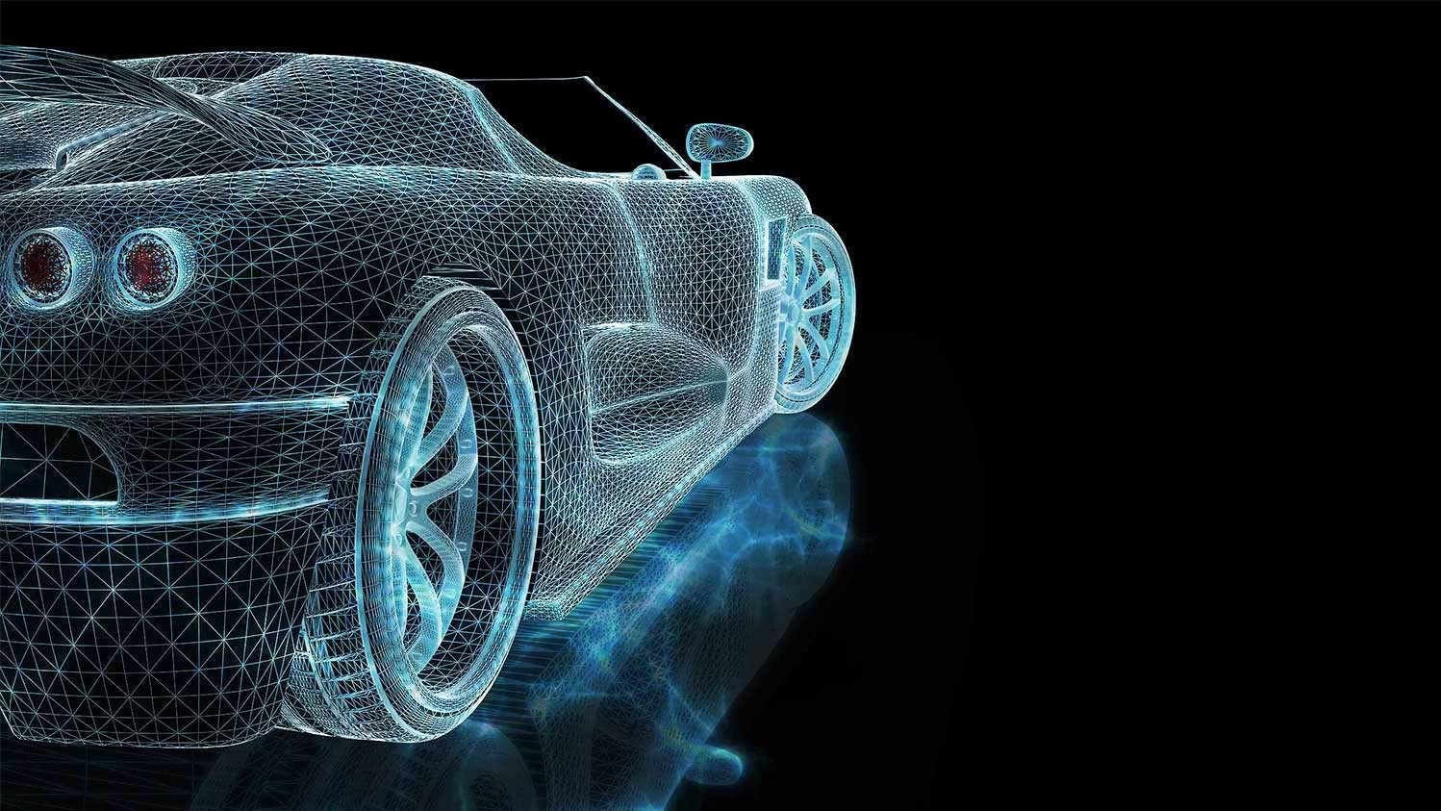

IoT-BASED EV SMART PARKING AND GREEN CHARGING SYSTEM
Project Members:
Kushal Singh
Anmol Maddeshiya
Siddharth Singh
Satyam Kumar
Guide Name :
Mr. Nishant Anand

Slide 2
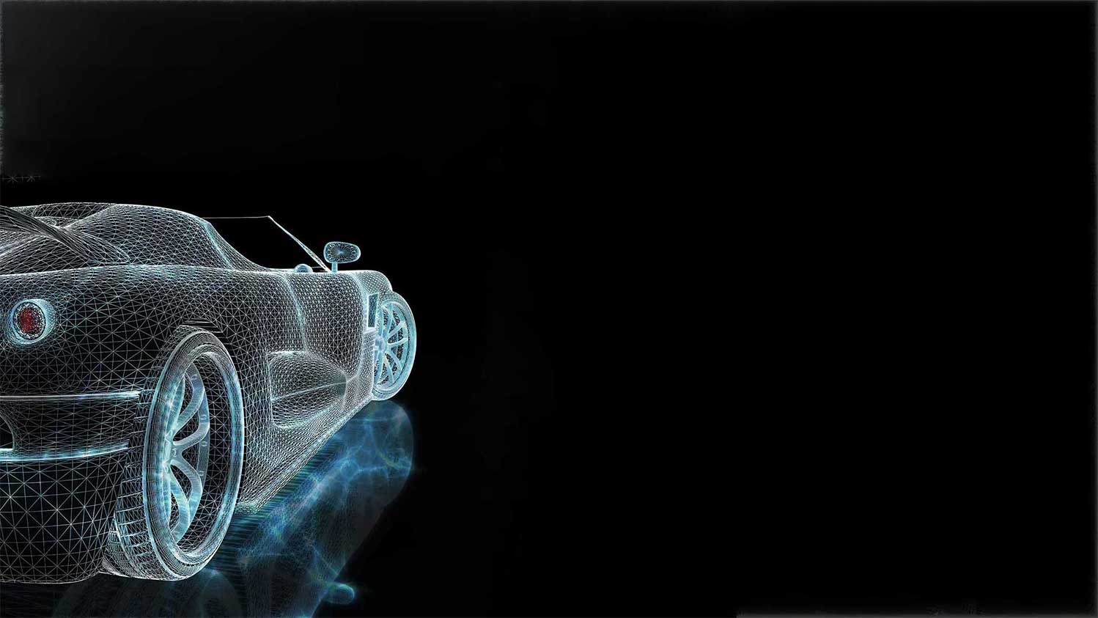
Problem Statement :
Urban living needs centralized public facilities.
Almost no car parking facilities in operation today can handle the flood of vehicles.
It takes time to look for a vacant parking space.
It causes increased traffic congestion since many vehicles may compete for limited parking spaces.
After that there is also a problem with EV charging points across the city.
EV charging points are yet to upgrade to a renewable source of energy.

Slide 3
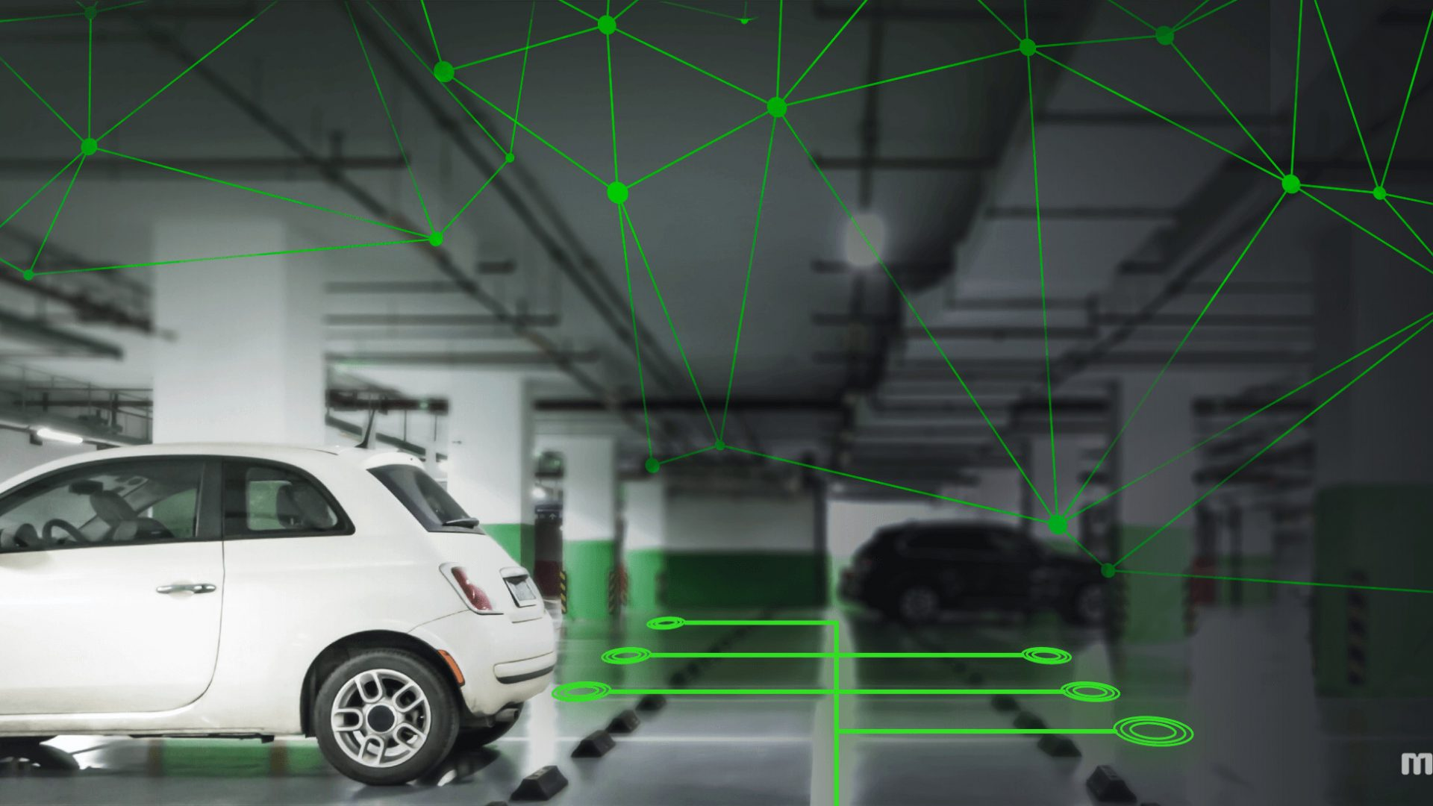
Proposed Solution :
To provide information about slot availability for parking using IoT App/Browser.
To provide wired charging of Electric Vehicle .
To provide green charging using solar panels.

Slide 4

Hardware components :
Node MCU/ Wi-Fi ESP-32
Arduino UNO
Power hub
6 IR Sensors
Servomotor
16x2 LCD Display
Solar Panel(15V)
Programming cables
LM35 Temperature Sensor
Diode, LED, Capacitor
Battery(12V)
Regulator 7805

Slide 5

Software Used :
Arduino IDE 1.8.15
Internet of Things (IoT) App.

Slide 6

Flow diagram:

Slide 7

Conclusion :
Optimised Parking
Reduced Traffic and Reduced Pollution
Green charging system
New Revenue Options
Fast Payments
Decreased Management Costs
Real-Time Data and Trend Insight

Slide 8

ABSTRACT:
The development and growth of electric vehicles(EVs) have increased several folds during the last 10 years. EVs are a green and sustainable alternative to LPG and diesel vehicles that pollute and threaten the environment, especially for CO2 reduction and alternative energy uses. Due to the increasing popularity of EVs nowadays there is an increased demand for charging stations. Additionally, parking cars has always been a difficult chore. Consequently, EV also needs a reliable parking system. Our current project entails "Smart Parking as well as Green Charging system of EV." We are using the Node MCU, Arduino UNO, Servomotor, and 6 IR sensors to develop an IOT-based car parking system. For a hassle-free parking system, we leverage the Internet of Things (IoT) and getting the information on Blynk application about the slot availability. The 2nd part of the project deals with the challenge of charging the EVs using a 15V solar panel that would be used to charge a 12V battery which rests on the platform where the designated car is parked.

Slide 9

THANK YOU

